Slide 1
CSE 3203
Lecture 11
Topic: Informed Search, Heuristic Information, Hill Climbing Methods

Slide 2
Informed Search
When more information than the initial state, the operators, and the goal test is available, the size of the search space can usually be controlled. When this is the case, the better the information available, the more efficient the search process will be. Such methods are known as informed search methods. They often depend on the use of heuristic information.

Slide 3
Search Space
The space of all feasible solutions (the set of solutions among which the desired solution resides) is called search space (also state space). Each point in the search space represents one possible solution.

Slide 4
Heuristic Information
A heuristic is a rule of thumb or judgmental technique that leads to a solution some of the time but provides no guarantee of success. It may in fact end in failure. Heuristics play an important role in search strategies because of the exponential nature of most problems. They help to reduce the number of alternatives from an exponential number to a polynomial number and, thereby, obtain a solution in a tolerable amount of time.

Slide 5
Hill Climbing Algorithms
There are 4 important properties in hill climbing algorithm. They are :
Local Search Algorithm
Greedy Approach
Beam value(β) = 1
No backtracking

Slide 6
Hill Climbing Algorithms
Local Search Algorithm: In hill climbing algorithm, we have knowledge about the local domain of the problem. It does not know about the global domain of the problem. The algorithm finds the best solutions among the adjacent neighboring states. When it reaches a local maximum value at the peak of the hill, the algorithm gets stuck. It can not go down the hill.
Greedy Approach: The hill climbing algorithm picks the best solution at the current moment. It does not think about whether picking that solution will lead to the optimal solution of the whole problem.

Slide 7
Hill Climbing Algorithms
Beam Value(β) = 1: Beam value,β, denotes the number of recent best solutions the algorithm will store in the memory. For Beam Search algorithm, the β value is a finite number(2,3,…).A β value of 2 means the algorithm will store the recent best 2 solutions in the memory and prune(or deletes) all other solutions. For hill climbing algorithm, the β value is 1 which indicates that the algorithm stores only the current best solution in the memory and prune all other solutions. That’s why when we reach the peak of a hill, we can not go down, we get stuck!

Slide 8
Hill Climbing Algorithms
No Backtracking: When the algorithm reaches the local maximum(peak of a hill), the algorithm gets stuck. It can not backtrack to find the other better solutions because it already prune all other solutions.

Slide 9
Hill Climbing Method
In Hill Climbing, the algorithm starts with an initial solution and then iteratively makes small changes to it in order to improve the solution. These changes are based on a heuristic function that evaluates the quality of the solution. The algorithm continues to make these small changes until it reaches a local maximum, meaning that no further improvement can be made with the current set of moves.

Slide 10
Hill Climbing Method
Hill climbing is like depth-first searching where the most promising child is selected for expansion. When the children have been generated, alternative choices are evaluated using some type of heuristic function. The path that appears most promising is then chosen. This process continues from node-to-node with previously expanded nodes being discarded. A typical path is illustrated in Figure below where the numbers by a node correspond to the computed estimates of the goal distance for alternative paths.

Slide 11
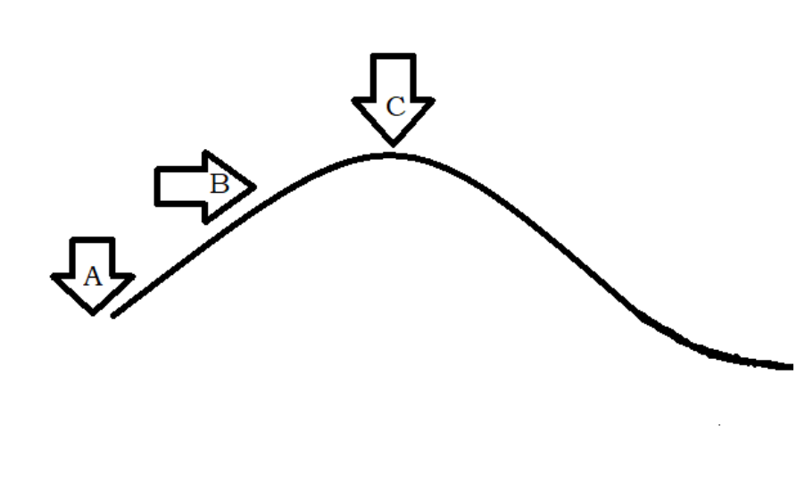
Hill Climbing Method
Let us describe this algorithm in another way.
If we see this approach with an analogy to hill climbing, the algorithm begins at point A. Here, the point of highest elevation provides the most optimal solution. So, at point A, the algorithm decides to take a step forward, as the height is increasing in that direction.

Slide 12
Hill Climbing Method
Let us describe this algorithm in another way.
At the next step, all neighbours are checked, which, in this simplified case, are a forward step or a backward step. Since, we need to go uphill, we take a forward step. The algorithm continues this way, taking forward steps until the peak C is reached. At point C, no further steps either forward or backward can take us any higher. So, point C is returned as the solution.

Slide 13
Hill Climbing Method
So, Hill climbing algorithm is a greedy local search algorithm in which the algorithm only keeps track of the most immediate neighbours. Once a step has been taken, you cannot backtrack by multiple steps, because the previous states are not stored in memory. At every point, the solution is generated and tested to check if it gives an optimal solution to our problem.

Slide 14
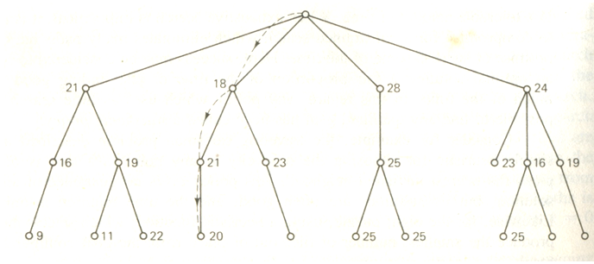
Hill Climbing Method

Slide 15
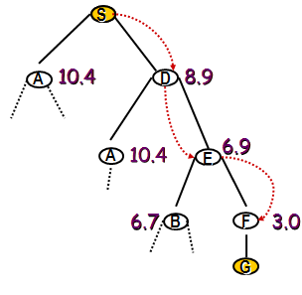
Hill Climbing Method
Example: Using the Straight Line Distance
Perform depth-first, BUT:
instead of left-to-right selection,
FIRST select the child with the best heuristic value

Slide 16
Hill Climbing Method
Hill climbing can produce substantial savings over blind searches when an informative, reliable function is available to guide the search to a global goal. It suffers from some serious drawbacks when this is not the case. Potential problem types named after certain terrestrial anomalies are the foothill, ridge, and plateau traps.

Slide 17
State Space Diagram Hill Climbing Method
The state-space diagram is a graphical representation of the set of states our search algorithm can reach vs the value of our objective function(the function which we wish to maximize).
X-axis: denotes the state space i.e. states or configuration our algorithm may reach.
Y-axis: denotes the values of objective function corresponding to a particular state.

Slide 18
State Space Diagram Hill Climbing Method
The state-space diagram is a graphical representation of the set of states our search algorithm can reach vs the value of our objective function(the function which we wish to maximize). The best solution will be a state space where the objective function has a maximum value(global maximum).
.

Slide 19
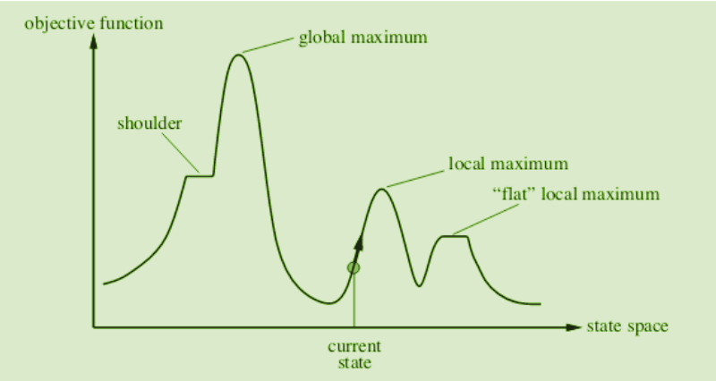
Different Regions in State Space Diagram Hill Climbing Method

Slide 20
State Space Diagram Hill Climbing Method
Local maximum: It is a state which is better than its neighboring state however there exists a state which is better than it(global maximum). This state is better because here the value of the objective function is higher than its neighbors.
Global maximum: It is the best possible state in the state space diagram. This is because, at this stage, the objective function has the highest value.

Slide 21
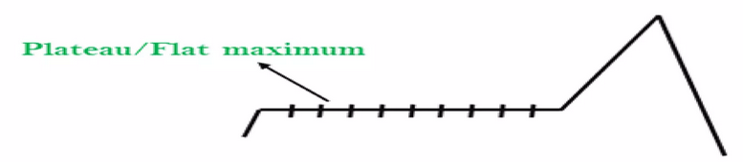
State Space Diagram Hill Climbing Method
Plateau/flat local maximum: It is a flat region of state space where neighboring states have the same value.

Slide 22
State Space Diagram Hill Climbing Method
Current state: The region of the state space diagram where we are currently present during the search.
Shoulder: It is a plateau that has an uphill edge.

Slide 23
Solutions to some of the Problems
To overcome the local maximum problem: Utilize the backtracking technique. Maintain a list of visited states. If the search reaches an undesirable state, it can backtrack to the previous configuration and explore a new path.
To overcome the plateau problem: A plateau is the flat area of the search space in which all the neighbor states of the current state contains the same value, because of this algorithm does not find any best direction to move. A hill-climbing search might be lost in the plateau area.

Slide 24
Solutions to the Problems
The solution for the plateau is to take big steps while searching, to solve the problem. Randomly select a state which is far away from the current state so it is possible that the algorithm could find non-plateau region.

Slide 25
References
1. https://www.youtube.com/watch?v=mAA4Gm1oOAc
2.https://www.geeksforgeeks.org/introduction-hill-climbing-artificial-intelligence/

Slide 26
End

